Slide 1

CSCI-3753: Operating Systems Spring 2021
Biljith Thadichi
Department of Computer Science University of Colorado Boulder

Slide 2
LKM – Quick Recap
What are the two main functions required in a LKM code?
How do you load the module into the kernel? How do you unload the module from the kernel?
2

Slide 3
PA2 – Character Device Driver
Programs
User Space
Open, Read, Write, Close, Seek
Device File (/dev/<name>)
File Operations
Device Driver
<name>
<major>:<minor>
<minor>
Kernel
Physical Device
3

Slide 4

malloc()
malloc is used to allocate memory on the heap dynamically
#
Size in number of bytes that you want to allocate
What is a void* pointer?

Slide 5
malloc()
malloc is used to allocate memory on the heap dynamically
#
Size in number of bytes that you want to allocate
Q: What is a void* pointer?
A: It just holds an address. It can point to any data type in memory

Slide 6

malloc()
#
Using malloc to allocate BUFFER_SIZE bytes in the heap
Q: What is (char *) doing here?

Slide 7
malloc()
#
Using malloc to allocate BUFFER_SIZE bytes in the heap
Q: What is (char *) doing here?
A: It is casting void pointer returned by malloc into a char pointer

Slide 8
malloc()
#
Using malloc to allocate BUFFER_SIZE bytes in the heap
A char * basically represents an array of characters and it points to the first element in the array
Q: What is (char *) doing here?
A: It is casting void pointer returned by malloc into a char pointer

Slide 9

open()
#
Specifies the file access modes. Can be one of
O_RDONLY
O_WRONLY
O_RDWR
There are other flags you can combine like O_RDONLY | O_CREAT
Open returns a file descriptor (fd). An fd identifies an open file of the process and acts as an index into the open file table.

Slide 10

read()
#
Read() returns the number of bytes that were actually read.
First parameter is the fd of the file you want to read from.
Specifies the max number of bytes to read.

Slide 11

write()
#
write() returns the number of bytes that were actually written
This maybe less than size for example if there is insufficient space.
First parameter is the fd of the file you want to read from.
Specifies the number of bytes to write to file.

Slide 12
offset in a file
Whenever a file is opened by a process, an fd is associated with it.
Following the indirection below, we reach the struct file associated with the open file.
This struct keeps track of a lot of information like the offset in the file.
The offset is the location from which a read or write will take place.
After every read/write operation, the offset is adjusted to the end of what was just read/written.
#
A good read for struct file can be found here
0
1
struct fd (file descriptor structure)
struct file(open file description)
…
fd
loff_t f_pos
fd + 1

Slide 13
offset in a file
#
Q: What do file descriptor 0, 1 and 2 usually point to?
A good read for struct file can be found here
0
1
struct fd (file descriptor structure)
struct file(open file description)
…
fd
loff_t f_pos
fd + 1

Slide 14
offset in a file
#
What do file descriptor 0, 1 and 2 usually point to?
A: They point to stdin, stdout and stderr respectively.
0
A good read for struct file can be found here
1
struct fd (file descriptor structure)
struct file(open file description)
…
fd
loff_t f_pos
fd + 1

Slide 15
lseek()
#
Returns the new offset in the file measured in the number of bytes from the beginning of the file.
First parameter is the fd of the file you want to read from.
Specify the offset you want. The last parameter whence determines how this value is interpreted

Slide 16
lseek()
#
The value for whence can be either of the following
SEEK_SET - The file offset is set to desired_offset bytes.
SEEK_CUR - The file offset is set to its current location plus desired_offset bytes.
SEEK_END - The file offset is set to the size of the file plus offset bytes.
Q: How would you use SEEK_END to set the offset to 4 bytes from the end of the file?

Slide 17
lseek()
#
The value for whence can be either of the following
SEEK_SET - The file offset is set to desired_offset bytes.
SEEK_CUR - The file offset is set to its current location plus desired_offset bytes.
SEEK_END - The file offset is set to the size of the file plus offset bytes.
Q: How would you use SEEK_END to set the offset to 4 bytes from the end of the file?
A: Using a negative desired_offset

Slide 18

close()
#
Closes a file descriptor, so that it no longer refers to any file and may be reused.
Returns 0 on success, -1 on error.
If file_desc is the last fd referring to the underlying open file description (struct file), the resources associated with the open file description are freed.

Slide 19
Good practices
Use #define to define constants to use throughout the code
#define SIZE 10
Allows a single modification to change the value across the code
Make the code modular. Think of removing code pieces from main and putting it into its own function
Some functions may cause buffer overflow, avoid using them.
Always free() memory that you allocated using malloc.
#

Slide 20
PA1 questions?

Slide 21
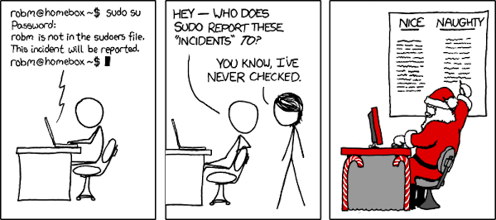
TODO
Complete Week 3 quiz
Play around with using open(), read(), write(), seek() and close()
Have a great weekend!
#

